Slide 1
Instagram User Analytics - Analyzing User Interactions and Engagement SQL Fundamentals
By LAVANYA B

Slide 2
1. Project Description
The goal of this project is to analyze Instagram user behavior, engagement patterns, and popular features, such as hashtags. By examining the data from various tables, I aimed to derive insights into the best times to schedule campaigns, how active users are in posting, and identifying potential bots or fake accounts. The project focuses on extracting and analyzing information from tables like users, photos, tags, photos_tags, likes, comments, and follows.
Key Tasks:
Analyze user behavior and engagement.
Identify the most popular hashtags.
Determine the best days for scheduling campaigns based on user registration activity.
Identify users with abnormal engagement patterns that may indicate fake or bot accounts.

Slide 3
2. Approach
Data Extraction and Understanding: I began by familiarizing myself with the structure of the database,
specifically focusing on the key tables:
users: Contains information about registered users.
photos: Contains the photos uploaded by users.
tags: Contains the hashtags used in posts.
photos_tags: Links photos to hashtags.
likes: Records the likes users give to photos.
comments: Contains comments made by users on photos.
follows: Contains follow relationships between users.
Each table has structured columns, which made it easy to extract the required data and perform efficient analysis using SQL.
Key SQL Queries: I wrote and executed several SQL queries using DML (Data Manipulation Language), JOIN functions, and aggregation functions like COUNT(), GROUP BY, HAVING, etc., to answer the key questions.
Execution of Queries: I ran various complex queries involving joins and subqueries to analyze user activity, engagement levels, and behavior.
Visualization and Interpretation: After executing the SQL queries, I analyzed the outputs and interpreted the data to gain insights into user behavior, identify trends, and draw meaningful conclusions.

Slide 4

3. Tech-Stack Used
MySQL Workbench: MySQL Workbench was chosen as the primary tool because of its powerful features for running complex SQL queries and visualizing results. It allows easy management of databases and quick execution of queries, which was crucial for this project.

Slide 5
4. Insights
User Engagement:
Many users post infrequently, while a small subset of users post significantly more, indicating higher engagement.
Identifying Bot-Like Behavior:
Users who like an unusually high percentage of photos (e.g., over 50%) may indicate bot-like activity.
Best Days for Campaigns:
Analysis of user registration data hlped determine the days when most users register, useful for marketing campaigns and ad launches.

Slide 6
5. Result
Through this project, I was able to achieve several objectives:
Identifying Fake Accounts:
Users who liked an abnormally high number of photos were flagged as potential fake accounts.
Better Understanding of User Behavior:
Calculating the average number of posts per user helped derive insights into user interaction on the platform.
Improved Data Handling:
The project enhanced my ability to work with large datasets, aggregate functions, and data quality management.
These findings can be used to improve user experience by identifying suspicious behavior and enhancing overall engagement.
The insights derived from this analysis can be used by various teams within the business. For example, the marketing team might use these insights to launch a new campaign, the product team might use them to decide on new features to build, and the development team might use them to improve the overall user experience.

Slide 7
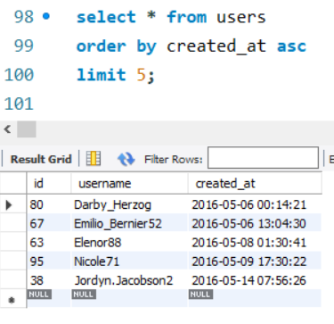
6. SQL Queries with Outputs
A. Marketing Analysis:
1.Loyal User Reward: Identify the Five Oldest Users on Instagram
Output: The top 5 oldest registered users were retrieved.
Here are the list of users and their details

Slide 8
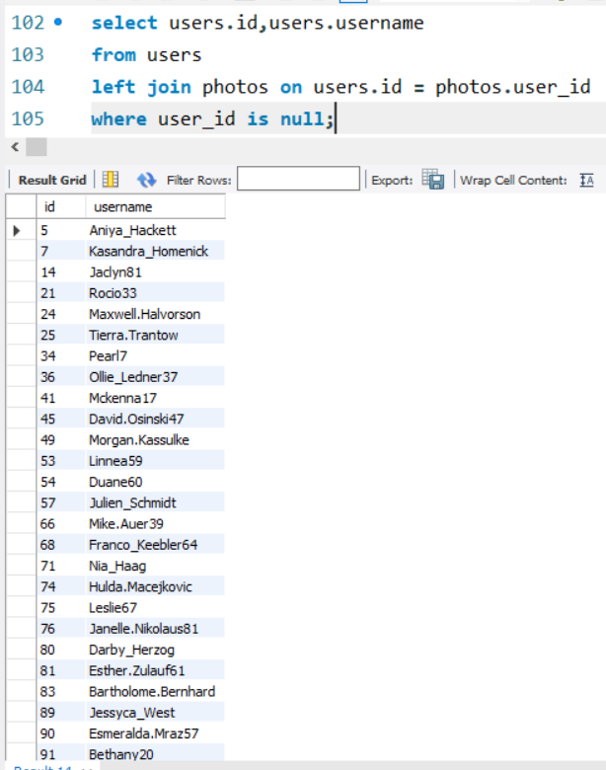
2.Inactive User Engagement: Identify Users Who Have Never Posted a Photo
Output: Users who have never uploaded any photos were identified.
Here are the list of inactive users and their details

Slide 9
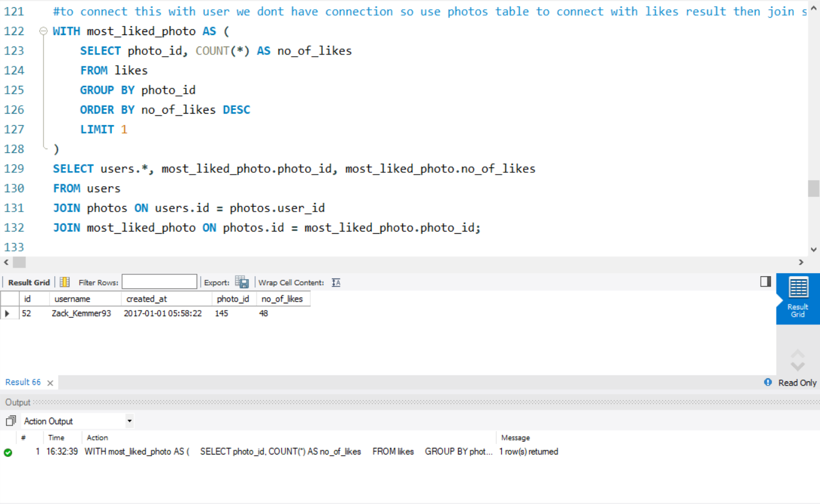
3.Contest Winner Declaration: Determine the Winner with the most likes on a single photo wins
Output: The user ZACK_KEMMER93 got the most likes on a single photo that he posted so the Team declare this user as the contest winner.

Slide 10
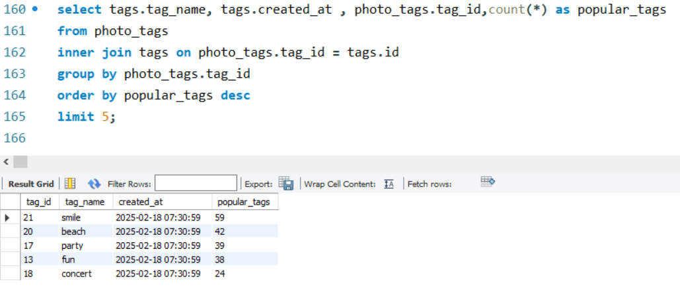
4.Hashtag Research: Identify Top 5 Most Popular Hashtags
Output: The most commonly used hashtags were identified.
#smile #beach #party #fun #concert

Slide 11
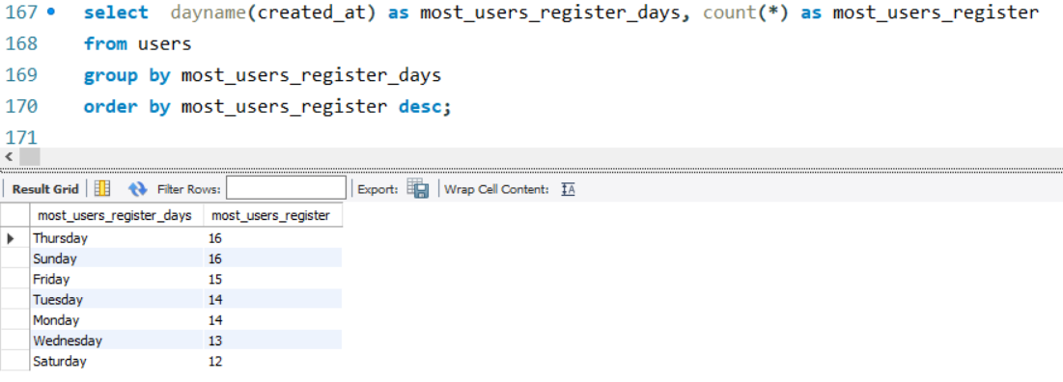
5.Ad Campaign Launch: Determine the Best Day of the Week to Launch Ads
Output: The best day to launch ad campaigns was determined based on user registrations. here SUNDAY and THURSDAY are the best days to launch ads.

Slide 12
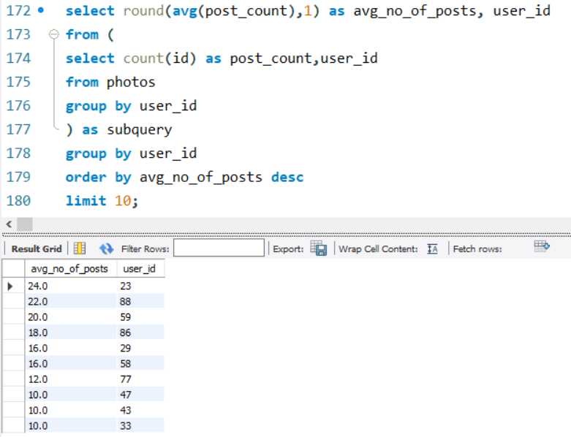
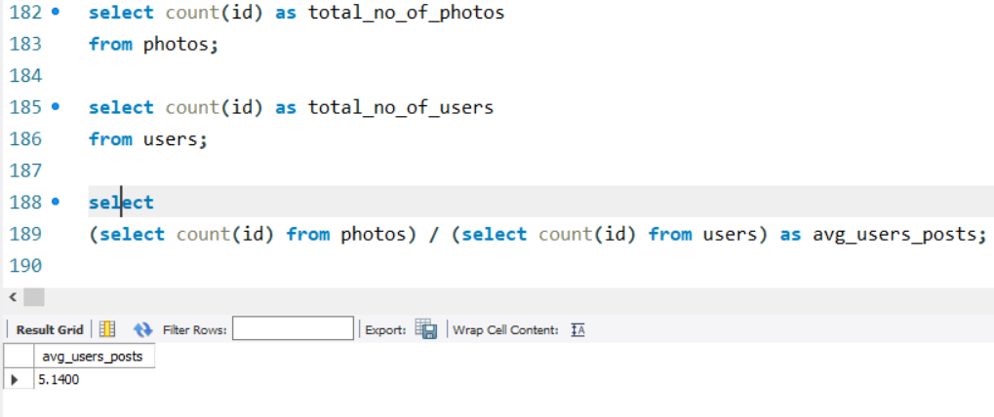
B. Investor Metrics:
1.
A. User Engagement: Calculate Average Number of Posts Per User.
Output: The average number of posts per user was calculated. Range between avg 24 – 10 posts per user.
B. Average posts posted by users on Instagram: total number of photos on Instagram divided by the total number of users.
Output: The average posts posted by all users on instagram was calculated. The value is 5.

Slide 13
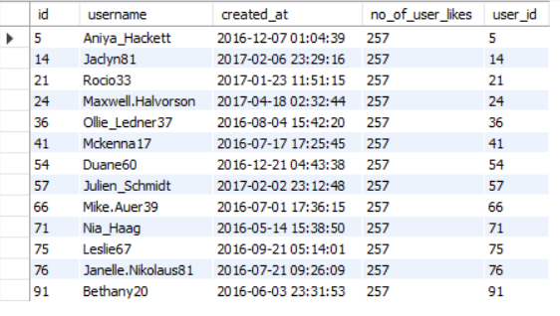
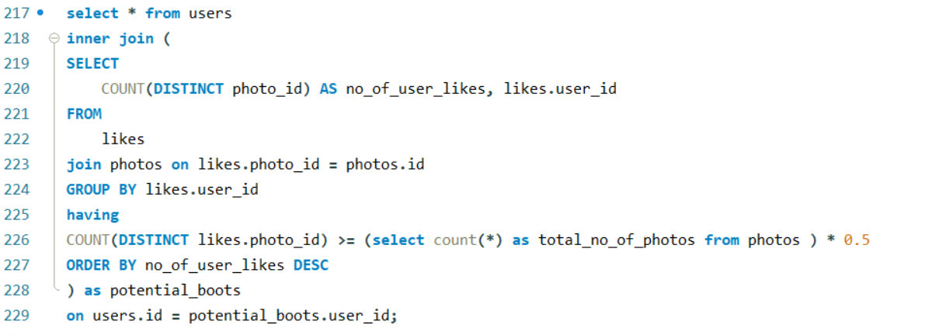
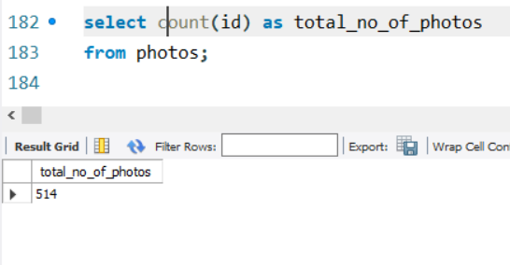
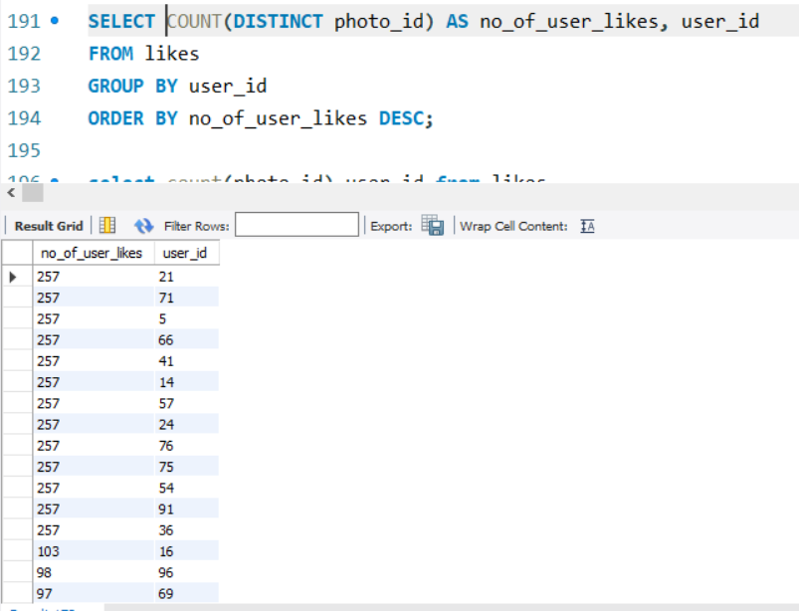
2.Bots & Fake Accounts: Identify Users Who Have Liked Every Photo on Instagram
Output: Users who liked a significantly high percentage that is more that 50% of photos were flagged for further analysis.
Output: Users who liked 50% of photos on instagram, that I attached as potential_bots. This is the max. number of likes done by users.
Output: This is the result of total number of photos on Instagram that posted.

Slide 14
7. Drive Link
To access the full project, including SQL scripts and output results, please refer to the following link:
https://drive.google.com/file/d/1qocmN8rxIi52PUJ6lnQnE3DnJsiVU60R/view?usp=sharing

Slide 15
Thank you By Lavanya B
This project helped me gain valuable insights into user behavior and engagement on Instagram.
By analyzing the data, I was able to identify potential bots, understand user engagement patterns, and suggest optimal days for marketing campaigns.
The process of querying and interpreting the data also enhanced my SQL skills, especially with advanced queries involving joins, aggregation, and subqueries.

